Slide 1

SYSLITE: Syntax-Guided Synthesis of PLTL Formulas from Finite Traces
M. Fareed Arif, Daniel Larraz, Mitziu Echeverria, Andrew Reynolds,
Omar Chowdhury, and Cesare Tinelli
Department of Computer Science, The University of Iowa
FMCAD’20

Slide 2






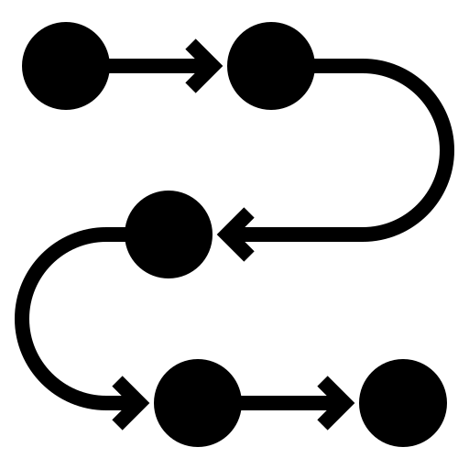


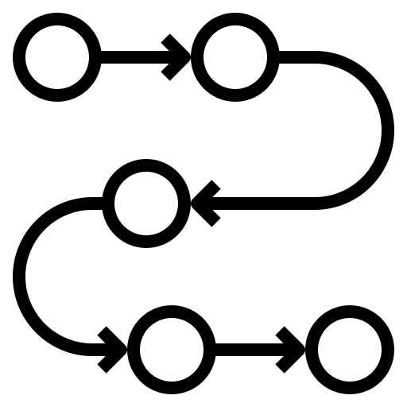
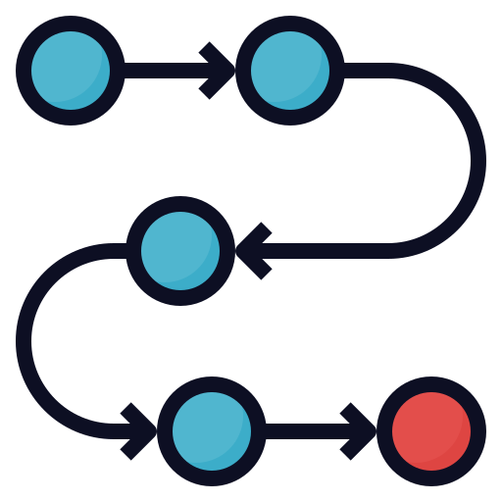



PLTL Formula Synthesis Problem
Atomic Propositions
PLTL formula synthesis problem is a special case of the language learning from the informant problem.
PLTL Formula Synthesizer
Disjoint
φ
PLTL Formula
Training/Sample Set

Slide 3




Applications of PLTL Synthesis
Security policy
mining
from system logs
Software and
system
debugging
Security/Privacy
policy
authoring
Attack signature
and root-cause
generation

Slide 4






Target application: Attacks on 4G LTE Protocol
Numb Attack
RLF Report
All of these control-plane attacks are due to a
buggy 4G LTE protocol state machine,
which is unable to handle out-of-order protocol packets
Denial of service
Privacy
AKA Bypass
Attack
EMM
Information
Eavesdropping
Spoofing

Slide 5







Cellular Device-centric Warning system
Monitor
Atomic propositions
PLTL formula
φ
PLTL Formula Synthesizer
Benign executions
Attack
signature
Attacks
Attack signature DB

Slide 6
Contributions
Identifying performance bottlenecks by exploring several solutions
Reducing the PLTL formula synthesis problem to the bit-vector function synthesis problem
SYSLITE on two case studies has a speedup of 28x-60x over the baseline

Slide 7
Motivation and Contributions
Background & Related work
SYSLITE
Evaluation
Summary

Slide 8
Background: Past-time LTL (PLTL)
Propositional Logic
Past temporal operators
Historically (H)
Once (O)
Yesterday (Y)
Since (S)
PLTL
b
a S b
a
Y(a)
Finite Trace
a

Slide 9
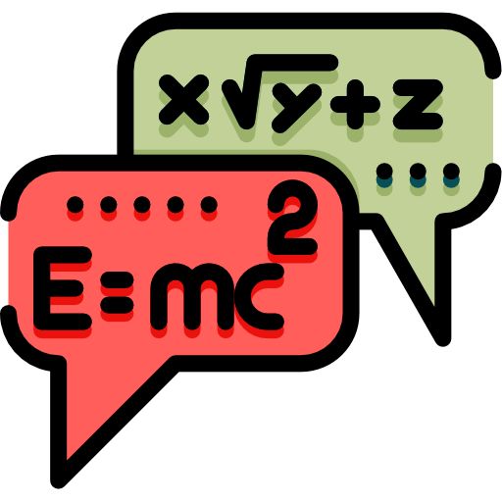


Background: Syntax-Guided Synthesis
Semantic
restrictions
Syntactic
restrictions
Synthesized
function
Syntax-guided Synthesizer (SyGuS Solver)
Context-free
Grammar

Slide 10
Cellular Device-centric Warning system
Monitor
Atomic propositions
Attack
Signature
Attack Signature Synthesizer
Benign executions
Attacks
Attack signature DB

Slide 11


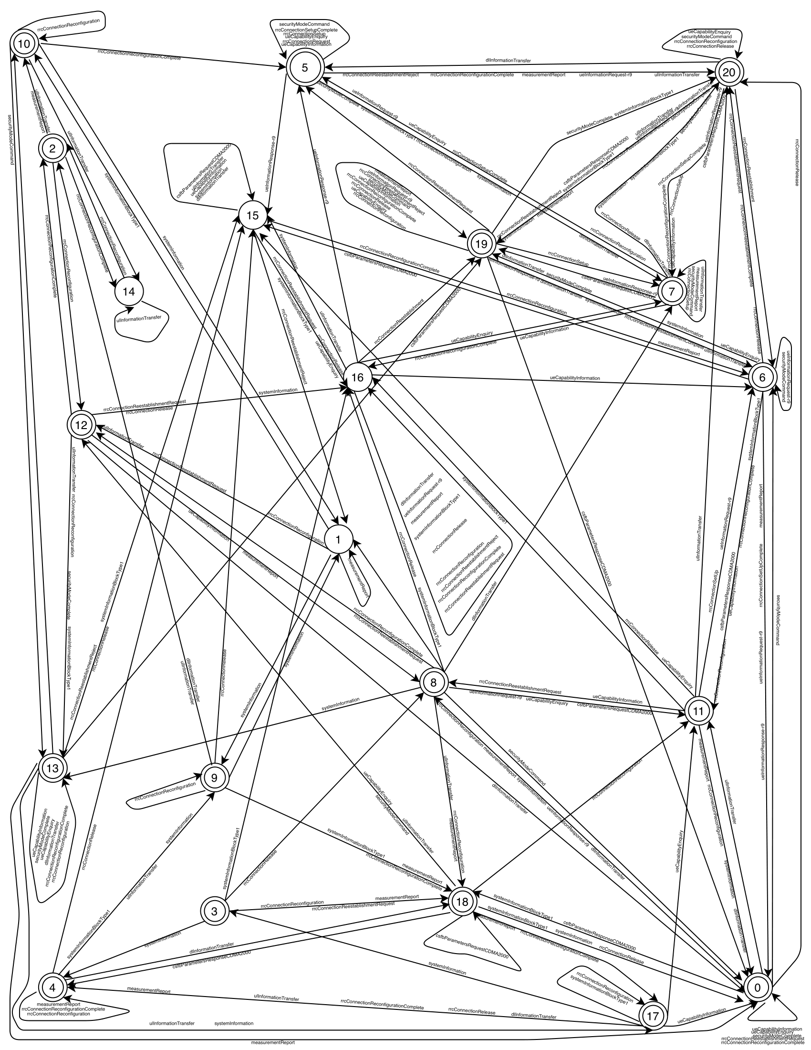

Attack Signature Representation
AKA Bypass Attack
DFA
PLTL formula
☐_{f}(CR → (¬SC S SMC))
DFA
SYSLITE generated
Space-efficient monitoring
Higher precision and recall
PLTL
formula
Understandable signatures
RPNI from LearnLib
Less scalable than RPNI

Slide 12

Prior work: LTL Formula Synthesis (Neider and Gavran, FMCAD’18)
LTL Formula Synthesis
Reduces
Boolean satisfiability problem
Future-only temporal operators
φ := ϒ^{d}_{syntax} ∧ ϒ^{d}_{semantics}
Based on infinite traces
Not scalable enough
From the model of this formula one can derive the goal LTL formula
Syntactic restriction of a
well-formed LTL formula
whose AST depth is d
Semantic restriction requiring the LTL formula to be consistent with the sample set.

Slide 13
Motivation and Contributions
Background & Related work
SYSLITE
Evaluation
Summary

Slide 14
Our Unsuccessful Attempts
Neider and Gavran’s
SAT-based approach adapted for PLTL
Reiners’s precomputation
based approach adapted for PLTL
SMT-based approach
with finite-model finding
SyGuS based approach
with ADT
Redundant formulas
High memory requirement
Insufficient symmetry breaking
Insufficient symmetry breaking
Insufficient symmetry breaking
Point-wise semantic checking
Point-wise semantic checking
Point-wise semantic checking
Precompute models
φ := ϒ^{d}_{syntax} ∧ ϒ^{d}_{semantics}

Slide 15



Lessons Learned
Symmetry breaking is essential for scalability
Natively supported theories (e.g., BV, LIA)
are amenable to specific optimizations
Point-wise semantic checking is a performance bottleneck

Slide 16

SYSLITE Insight Trace as Bit-vectors
Natively supported by SyGuS solver
Syntax-guided PLTL Formula Synthesis
Reduces
Bit-vector function synthesis
Variable-level projection
11001011
01001010
01000010
01001010
Trace-wise semantic checking
Defined as
PLTL temporal operators
Operations on bit-vectors

Slide 17
SYSLITE Design
`
SyGuS query
φ
CVC4 SY
Atomic
propositions
PLTL
Formula
Positive
traces
Consistency with samples as semantic restriction
Negative
traces
PLTL syntax as a context-free grammar
SYSLITE

Slide 18
Motivation and Contributions
Background & Related work
SYSLITE
Evaluation
Summary

Slide 19






Empirical Evaluation of SYSLITE
How effective is SYSLITE?
How scalable is SYSLITE?
Case study 1: Formulas from the literature
Case study 2: LTE control-plane attacks
Baseline: Based on Neider and Gavran’s SAT-based algorithm
Timeout: 3600 seconds
Memory limit: 15GB
Sample set size: 50, 100, 250, 500, 1250
80% Training set
20% Test set

Slide 20

Case study 1: Formulas from literature
How effective is SYSLITE?
8 PLTL formulas from literature
5
candidates
When not equivalent,
measure precision and
recall with respect to
test set.
SYSLITE
φ
Each seed PLTL formula
used as an oracle
Logically equivalent?

Slide 21
Case study 1: Results
 | SYSLITE | Baseline
Failed seed formula | 1 out of 8 | 4 out of 8
Equivalent instance generation | 31/40 (76%) | 11/40 (27%)
Precision and recall | 100%, 100% | 91.7%, 90%
Could failure to generate equivalent formula be attributed to timed-out?

Slide 22
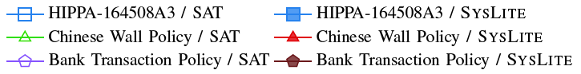
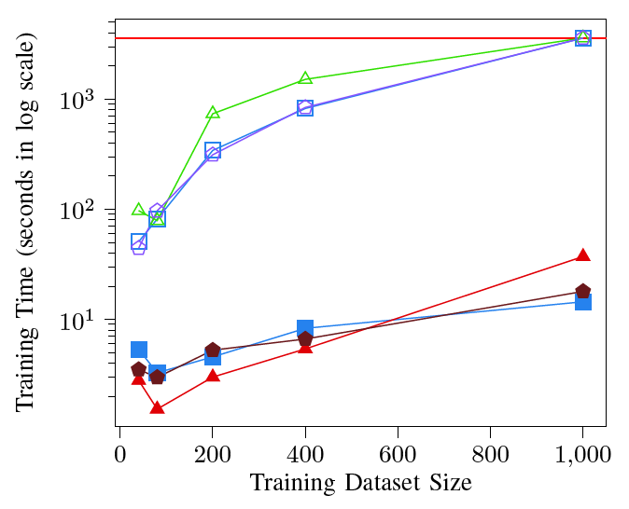
Case study 1
Timeout
Timeout | SYSLITE | Baseline
Instances | 3 out of 40 | 22 out of 40
Seed formulas | 1 out of 8 | 8 out of 8
60x over the baseline

Slide 23
Case study 2: Cellular Network Attacks
How scalable is SYSLITE?
10 Cellular network attacks
Benign trace of length 100 collected from MobileInsight crowd-sourced platform
Attack trace of length 100 collected from our cellular testbed built using SDRs

Slide 24
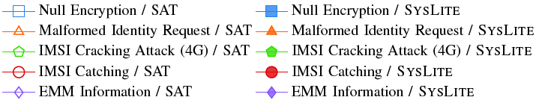
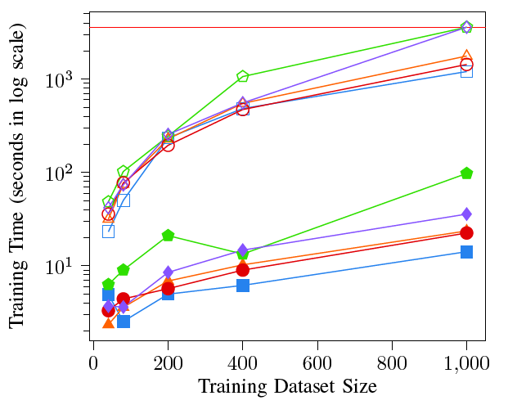
Case study 2: Results
 | SYSLITE | Baseline
Attack signatures | 10 out of 10 | 9 out of 10
Precision and recall | 100%, 100% | 100%, 100%
28x over the baseline
SYSLITE timed-out for a fewer number of instances

Slide 25
Motivation and Contributions
Background & Related work
SYSLITE
Evaluation
Summary

Slide 26
Summary
Explored several solutions for PLTL formula synthesis from finite traces and identified bottlenecks for each
Developed a scalable and efficient approach for PLTL formula synthesis
Implemented approach in a new tool, SYSLITE
SYSLITE can synthesize the correct formula while exhibiting a 28x-60x speed-up over the baseline

Slide 27
SYSLITE is open-source and is available at:
https://github.com/CLC-UIowa/SySLite

